Slide 1
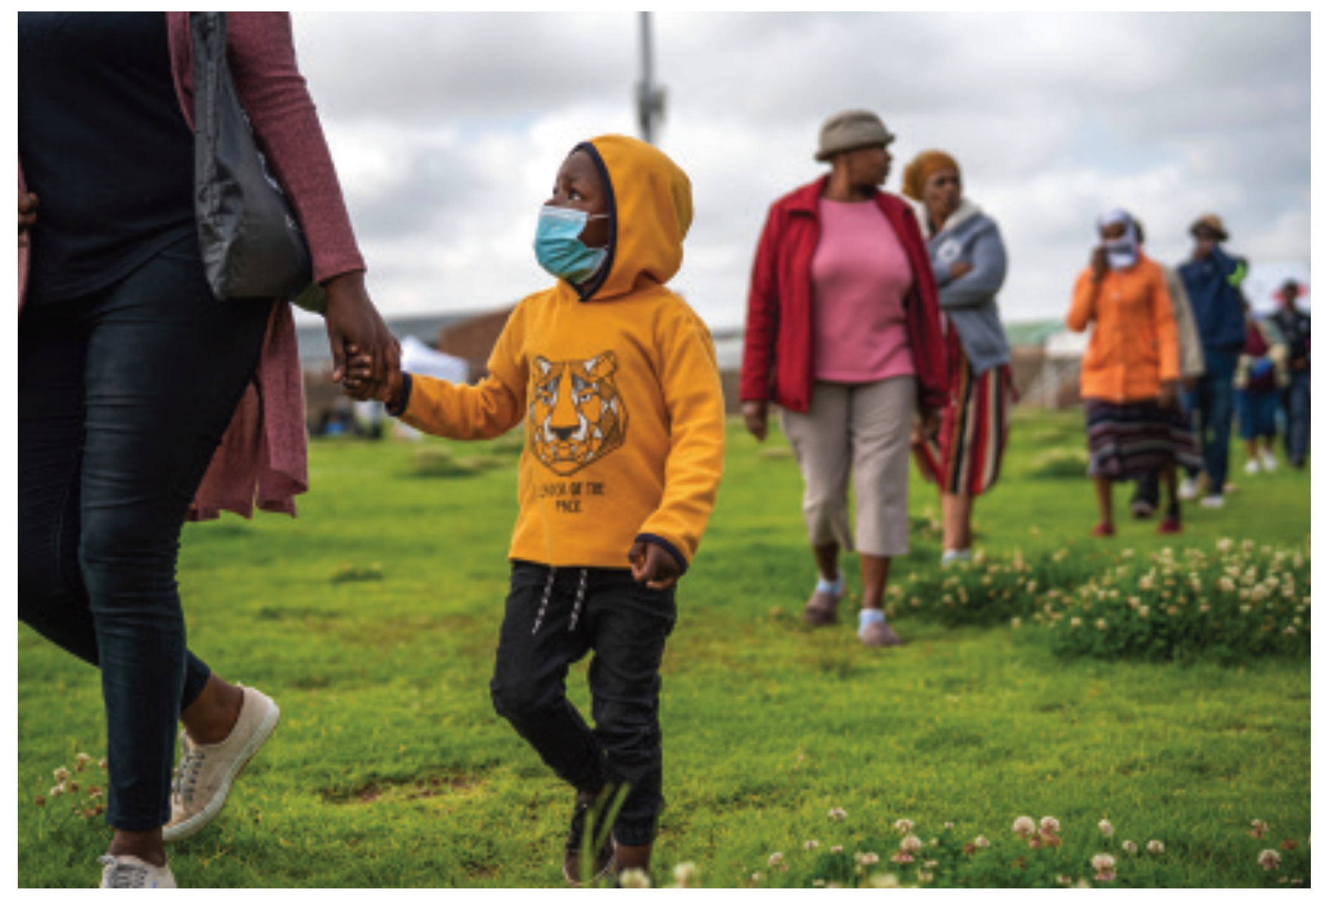
Safely re-opening schools in SA
28 May 2020
Nic Spaull | Daily Maverick Webinar

Slide 2
Key issues
COVID-19 will be with us for the next 2 years
Countries need to find ways of learning to live alongside the virus. We cannot keep schools closed for 2 years. In SA we cannot stop the spread of the virus, only the “intensity” of infections/deaths from COVID-19
SA context
17,000 infections 300 deaths, schools closed for 7 weeks, re-open on 1 June for Grade 7 and Grade 12 with PPE and social distancing, unions opposed, parents can choose. Likely schools will shut again in August when surge comes. Possibility of 2020 academic year totally compromised. LT labour-market implications, especially for the poorest children.
National shutdowns are costly
Learning losses, nutrition and school meals, immunizations, health-seeking behavior – people don’t go to clinics because they are afraid, other health issues (TB/HIV), household income, employment, tax revenue, etc.
Especially costly for children in the long term.
Safety of children, teachers and parents
This is primarily an “adult’s disease” – it does not affect children and adults in the same way. Children’s immune systems seem better able to fight off the disease.
Limiting the spread of the COVID-19 virus
School closures / lockdowns – for how long? Close schools for 6 months?
Handwashing (water/sanitation/infrastructure issues), masks (will children wear masks and use them properly?)
If economy re-opens, young children at home alone better than at school in class of 60?

Slide 3
Only 5% of positive cases in SA are children aged 0-14yrs (SAtotal=10,015), yet they are 29% of SA population

Slide 4
It is very VERY rare for children to get very ill or die from COVID-19.

Slide 5
Adults in SA (Madhi, 2020)
SA Paediatric Association Webinar: https://t.co/Q5d7mD6EiH?amp=1

Slide 6
Children in SA (Madhi, 2020)
SA Paediatric Association Webinar: https://t.co/Q5d7mD6EiH?amp=1

Slide 7
UK as at 6 May 2020
https://media.tghn.org/medialibrary/2020/05/ISARIC_Data_Platform_COVID-19_Report_6MAY20.pdf

Slide 8
Lockdowns and COVID-19 fear reducing immunizations, visits to doctors and clinics, + no school feeding
TB testing in SA is also down 50%
(NICD, 2020)
https://t.co/GhB1RBNECP?amp=1

Slide 9
Children and adults
Adults linked to schooling should be the focus of school-based precautions (teachers, parents and grand-parents)
Isolating/protecting high-risk categories (60+, diabetes, cardiac disease, hypertension)
Early retirement? (This will be with us for 2 years)
Get 4th year B.Ed students to replace teachers?
Children: Educating about hand-washing and mask-wearing, and vehicle for info to parents
Prolonged lockdowns and school closures clearly not in the best interests of children in SA

