Slide 1
ASEPA Profile
.
Matthew Johnson
National President – CEO ASEPA
Notes:
ACKNOWLEDGE COUNTRY / NATALIE / DEB / ROS and all of the WAESPAA organisation Stephen Baxter your DDG gave hope, President release, facilities and infrastructure acknowledgement

Slide 2
Acknowledgement of Country
I acknowledge the traditional owners of the land on which I live.
The Deerubin and Guringai peoples of the Euroa Nation. I pay my respects
to Aboriginal elders past and present and to the indigenous peoples of every land
and nation.
The first nation peoples of Australia have an acknowledged 40,000 year history
of continued culture and occupation of the landbut are not
officially recognised in the Australian Constitution.
Aboriginal, Australian and Torres Strait Islander Flags.

Slide 4
Kangaroos and Emus cant walk backwards….. That was the plan…. But they can… just slowly and with difficulty.

Slide 5
But Wallabies on the other hand CAN go backwards…..!!!!

Slide 6
But that’s OK the Queen is still the Australian Monarch….. All is well

Slide 7
Australia, officially the Commonwealth of Australia, is a sovereign country comprising the mainland of the Australian continent, the island of Tasmania, and numerous smaller islands.
It is the largest country in Oceania and the world's sixth-largest country by total area.
The total Australian population of 26 million is highly urbanised and heavily concentrated on the eastern seaboard. (just 2 Million short of the Shanghai population)!!!
Australia's capital is Canberra, and its largest city is Sydney. The country's other major metropolitan areas are Melbourne, Brisbane, Perth, and Adelaide.

Slide 8
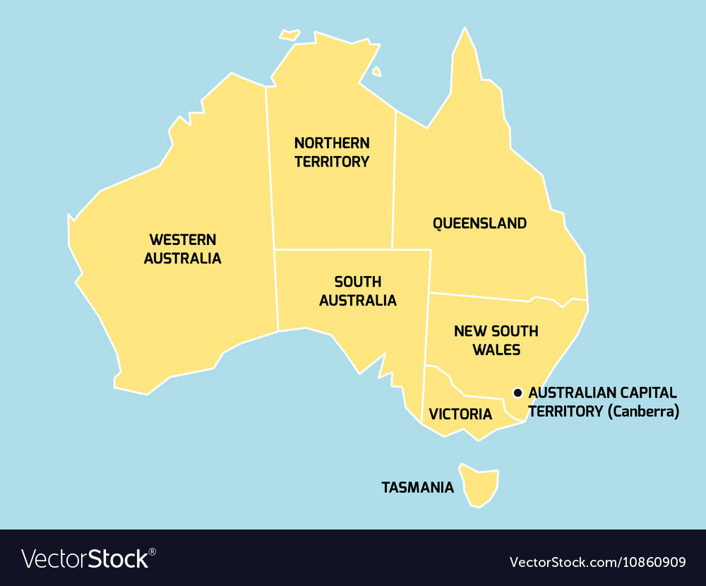
4000 KILOMETRES
3860 KILOMETRES
Australian States and Territories - One Federal department of education and eight state and territory departments of education

Slide 9
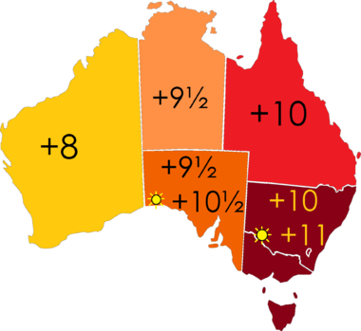
Standard time was introduced in the 1890s when all of the Australian colonies adopted it.
Before the switch to standard time zones, each local city or town was free to determine its local time, called local mean time.
Now, Western Australia uses Western Standard Time; South Australia and the Northern Territory use Central Standard Time; while New South Wales, Queensland, Tasmania, Victoria, and the Australian Capital Territory use Eastern Standard Time.
Time zones in Australia

Slide 10
Commonwealth Department of Education
Australian Capital Territory Department of Education
Northern Territory Department of Education
New South Wales Department of Education
Victorian Department of Education
South Australian Department of Education
Tasmanian Department of Education
Western Australian Department of Education
Tasmanian Department of Education
Under constitutional arrangements, state and territory governments are responsible for ensuring the delivery and regulation of schooling to all children of school age in their jurisdictions.
The Australian Government provides the majority of public funding for non-government schools, which is supplemented by states and territories.The states and territories provide the majority of public funding for government schools, with the Australian Government providing supplementary assistance.
States and Territories then use their own budget
to decide how much more money goes where and to whom. But due to The Australian Constitution the
Federal Government can’t tell states what to do.
Each State and Territory have their own Government, Parliament, police force, car licensing etc.Duplication and over-governance
Is how we roll.
How we are able to make our lives hard for ourselves and waste money on a national scale.

Slide 11
ASEPA Profile
ASEPA is the peak voice of leaders in special education and is representative of all states and territories. ASEPA is a proud member of the International Confederation of Principals (ICP).
ASEPA is the national voice for students, teachers and leaders in specialist education in Australia. ASEPA is connected, united and visible. ASEPA collaborates and leads at the state, national and international level.
Each state and territory in Australia has its own special education principals’ association (or affiliate), as well as primary, secondary, independent, private and faith based principals associations'. ASEPA is the National body representing each state and territory special education principal.
Each state and territory has a range of provision for students with special needs and disability. Special schools, specialist units, specialist classes, co-location, specialist centres, hospital schools, behavioural schools as well as specialist education support within mainstream settings.
Notes:
ACKNOWLEDGE COUNTRY / NATALIE / DEB / ROS and all of the WAESPAA organisation Stephen Baxter your DDG gave hope, President release, facilities and infrastructure acknowledgement

Slide 12
THE BOARD THE NATIONAL COUNCIL
Julie Raciborska, Secretary, NSW SEPLA – Fernhill School
Niki Takos, SA, SA-SEPLA Executive - Errington School
Peter Skinner, NSW, SEPLA President, George Bass School
Lara Coman, ACT, ACTPA Black Mountain School
Natalie Hatton, WA, WAESPPA President, Gwynne Park ESC
Jackie Lowther, VIC, PASS Management Member, Springvale Park SDS
Penny Moffat, VIC PASS Management Member, The Austin School
Lisa Wright, TAS The Northern Support School
Susan Christensen , QLD QASEL Southport Special School
Andrew Thompson, QLD, QASEL Redland Special School
Matthew Johnson NSW, ASEPA President / CEO – SEPLA Vice President Principal - Glenvale School
Dr Prof Fiona Forbes, WA, Board Chair
Director NESLI - Peel Language Development School
Craig Woodfall, TAS CEO - Department of Education Tasmania
Roselynne Anderson,
QASEL President
Byron Stuut, SA SASEPLA President
Cameron Peverett, VIC, PASS President - Colac Specialist School
Lorraine Hodgson, NT, Company Sectretary

Slide 13
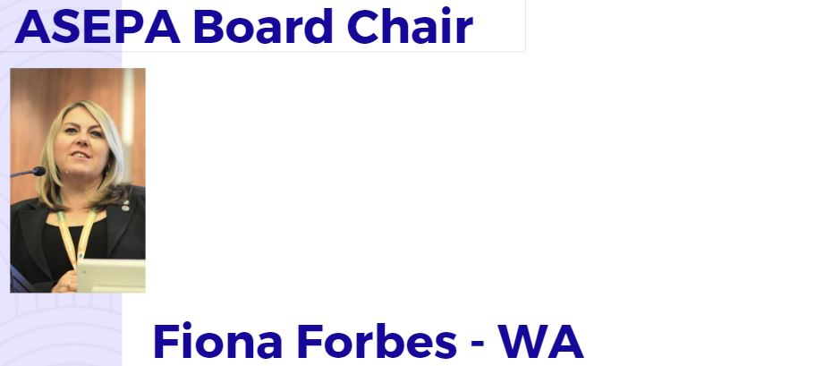
ASEPA BOARD 2019

Slide 14
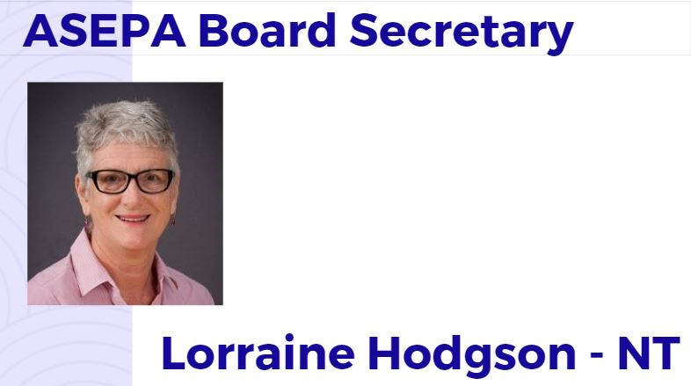
ASEPA Board

Slide 15
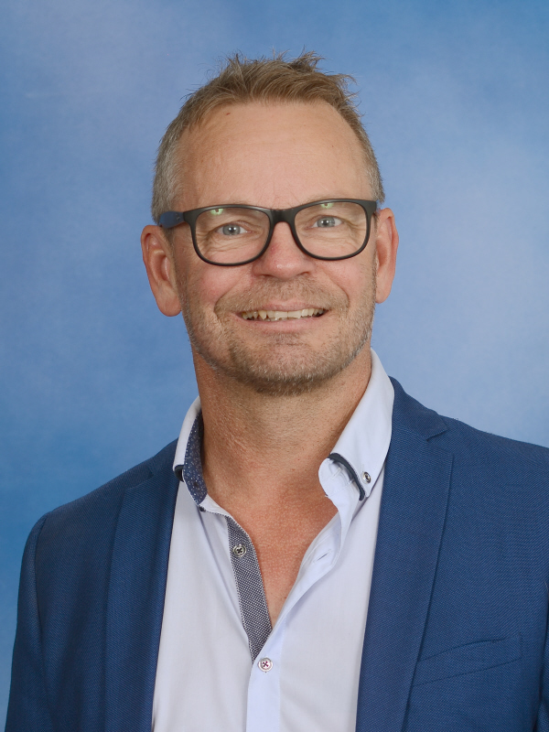
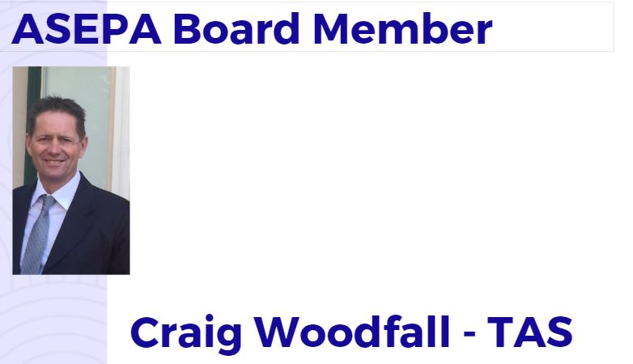
ASEPA Board
Byron Stuut

Slide 16
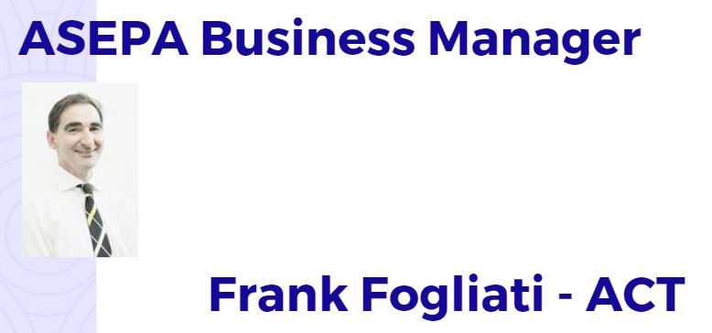
ASEPA Board

Slide 17
ASEPA & SEPLA 2020 NATIONAL SPECIAL EDUCATION CONFERENCE
The Australian Special Education Principals’ Association (ASEPA) holds a National Conference each two years in partnership with state and territory special education associations.
The ASEPA National Conference will be held in July 20-23 in Sydney, New South Wales Australia.

Slide 18
ASEPA NATIONAL PARTNERSHIPS
Australian Secondary Principals Association (ASPA) - President Andrew Pierpoint,
Australian Primary Principals Association (APPA) President Malcolm Elliot TAS
Australian Government Primary Principals Association (AGPPA) President Ian Anderson (WA)
Australian Council of State Schools Organisations (ACSSO) – CEO Diane Giblin AM
Association of Heads of Independent Schools of Australia (AHISA) Beth Blackwood CEO.
All State and Territory Primary and Secondary Principal Associations with the exception of the NSW SPC.

Slide 19
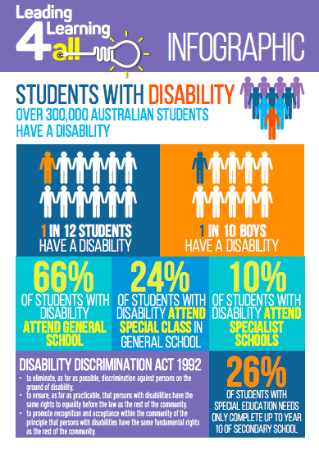
ASEPA’s Leading Learning 4 All Initiative
https://www.leadinglearning4all.edu.au/

Slide 20
Our Strategic Plan
From our previous work developing our Strategic Plan 2018 - 20 we need to be agile in reflecting and responding to the current educational environment.
This has led to our Work Plan

Slide 21
ASEPA Board and National Council Planning, 2019-20

Slide 22
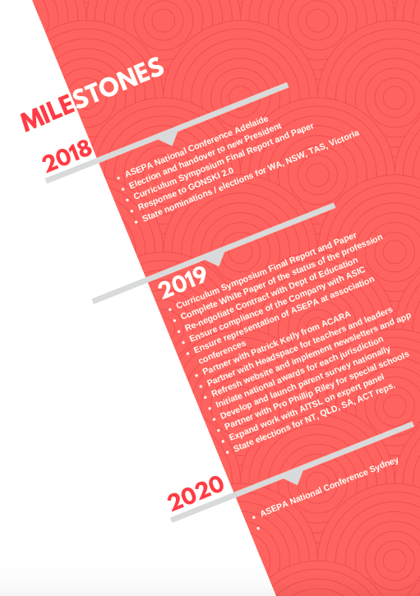
ASEPA WORKPLAN Milestones

Slide 23
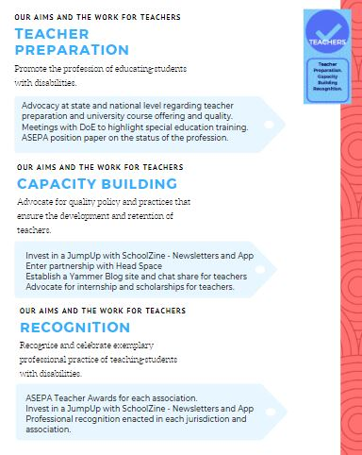
ASEPA Board and National Council Planning 2018-20 against our Big 3 Leaders Teachers Learners + Recognition

